Slide 1
Using K-Means to Help Plan Your Next Night Out
Diego Alcantara

Slide 2
The Problem
Cities are big and exploring them can be difficult
There are a lot of venues
Some are distributed across large areas
In some case driving is not the safest option (i.e. bar-hopping)
Wouldn’t it be easier to find one ”hotspot” of places to go out to on your night out?
Take one Uber to the location?
And have plenty to do for the evening?

Slide 3
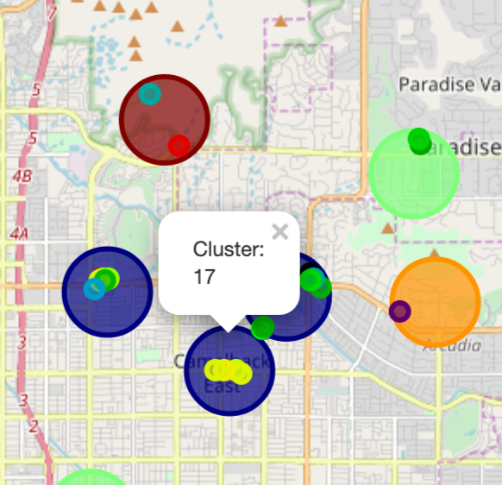
The Solution
Cluster groups of venues that are all walkable from each other and describe the clusters based on their similarity of venues
Now, you simply pick a cluster, examine the venues and go to the cluster(s) you want with the certainty that you can walk between venues

Slide 4
Data Acquisition
The data was sourced from Foursquare’s location API
First a RESTful call was made to the “explore” endpoint which allows us to search for venues within a 16km (~10mile radius)
This gave us a large distribution of venues around a city center
From this I used K-means to determine 800m (~0.5 mile) groupings of the venues to get areas of venues that are “walkable”
Any venues that did not were not in a .5 mile radius of a group were excluded
Next a RESTful call was made to “venues” endpoint to get further information on each the venues
This information was used to cluster areas based on their similarity venues within said clusters

Slide 5
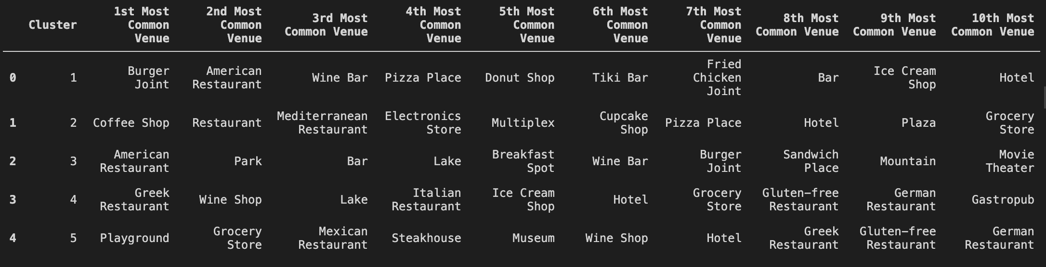
The Results
Distribution of top venues within each cluster

Slide 6
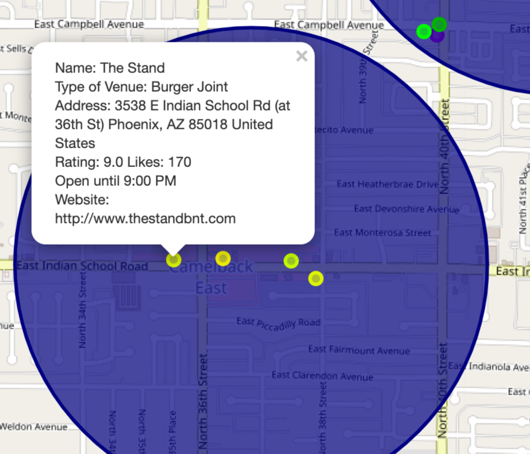
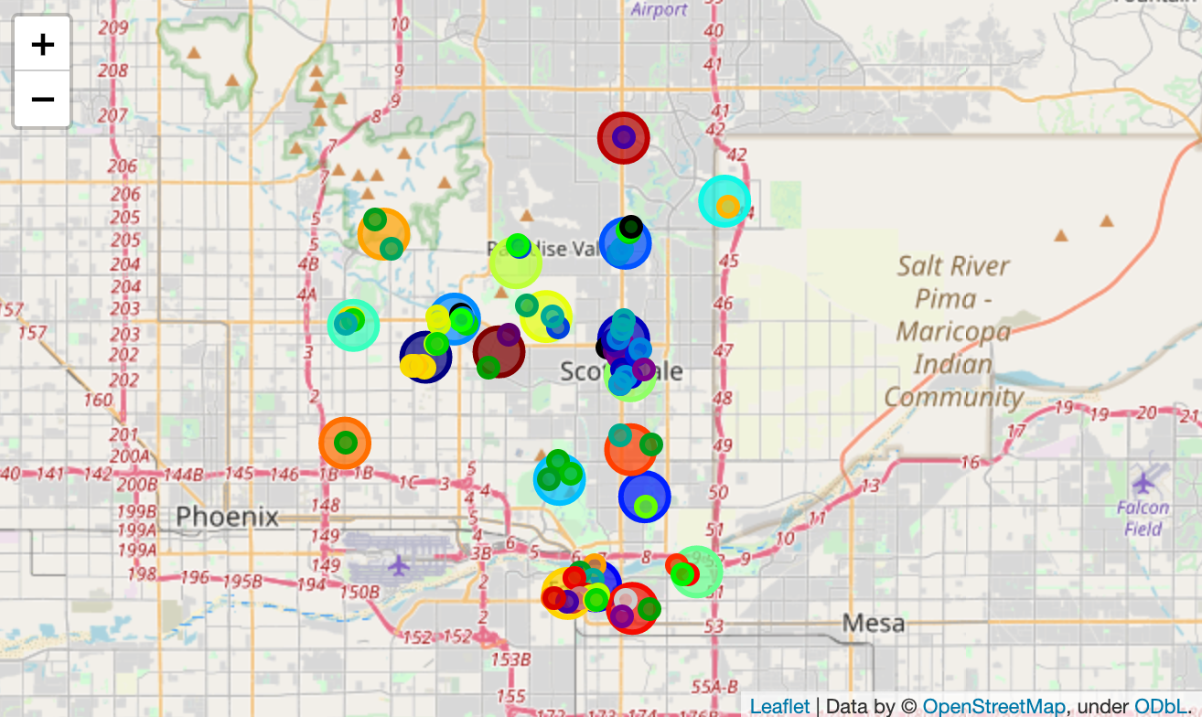
The resulting data is displayed on a Folium map
Distribution of venues and clusters across a city
Venue information is included for each venue

Slide 7
Clusters with similar top venues are colored the same
(as determined by the K-means algorithm)

Slide 8
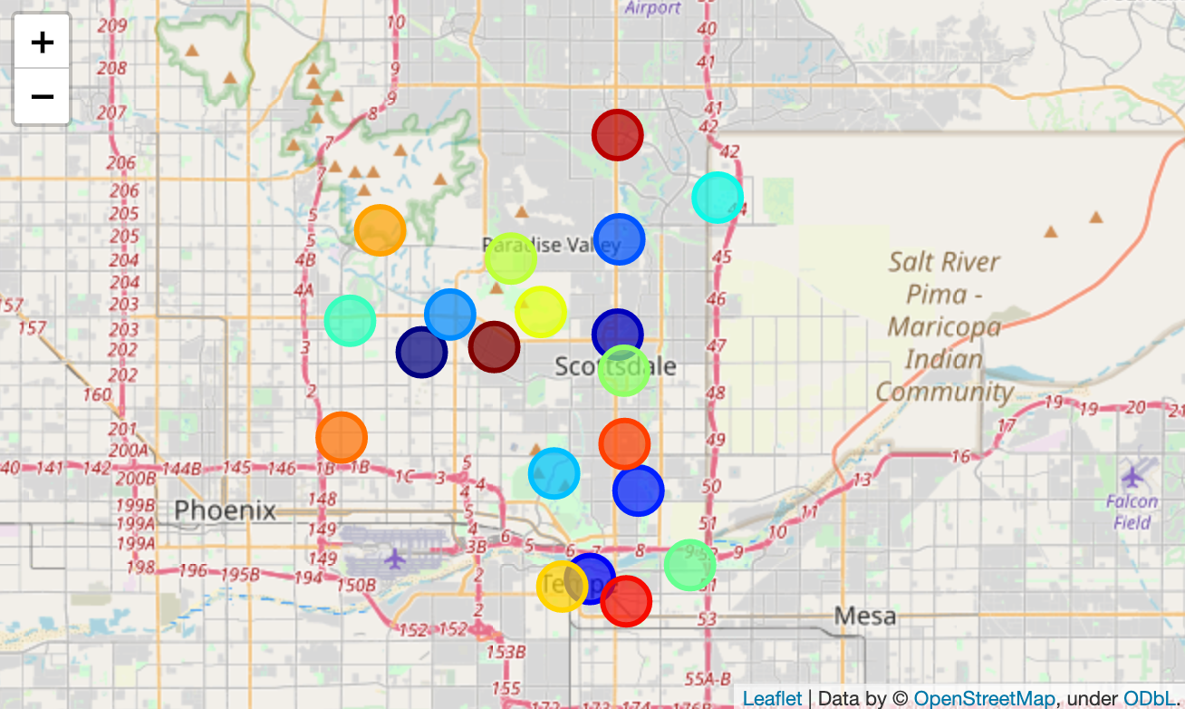
Benefits and Limitations
Using K-means as the approach to solve this issues is an interesting one
It works well to generalize to any city
It can determine similarities of groups
However it has some drawbacks
Not always mutually exclusive in its clusters
Not being consistent in its coverage
Examples of non-mutually exsclusive areas
Average Exclusions: 7.9, Stdev: 5.9, Min: 0, Max: 22

Slide 9
Conclusion and Future Work
The current system is generalizable to different cities in a robust way
This generalizability comes with some limitations
Future work to make the system better may include:
Using DBSCAN instead of K-means as DBSCAN works better with densities of data
Save original centroids from first run of the system to avoid inconsistent clustering with each iteration
Not being limited by Foursquare’s 100 venue query limit to see the true distribution of venues
This might also help with the way the “walkable” areas get defined as more venues gives the centroids more information on where to center themselves
Adding a description of the types of venues within each cluster rather than having to examine the individual venues within each cluster

